Slide 1
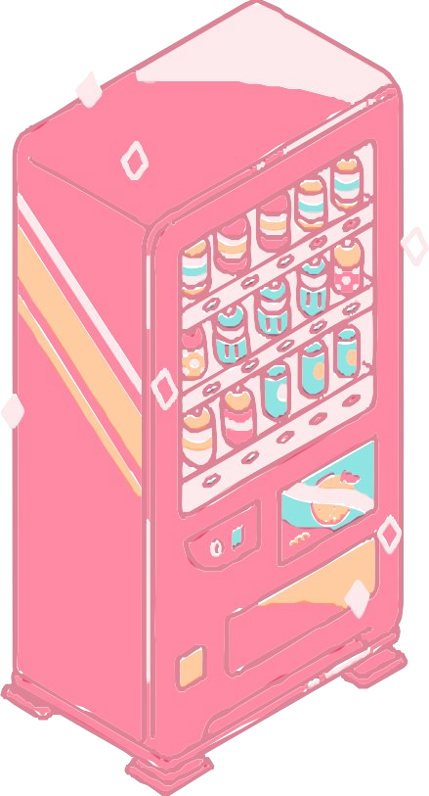
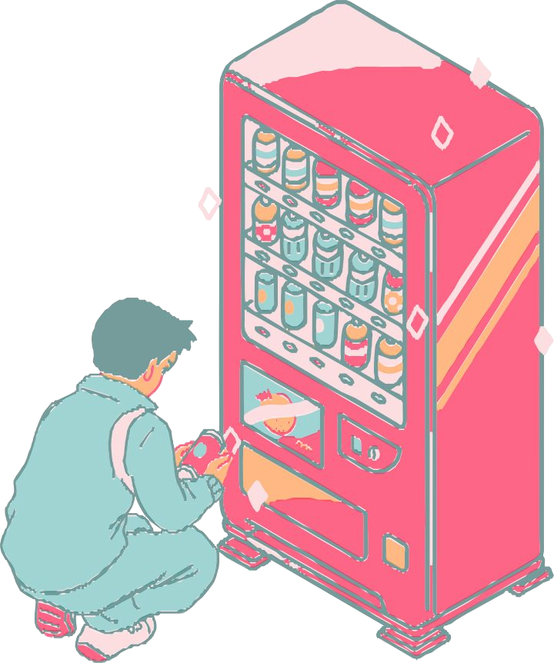
B U I L D I NG A VENDING SIMULATION SYSTEM WITH
JAVA
R A 2 2 1 1 0
28010065
R A 2 2 1 1 0
28010008

Slide 2
₀₄ Challenges
T A B L EO F C O N T E N T S
₀₁ Abstract
02 Different
₀₅ Impact
Application Used
₀₃ Functionaluty
₀₆ Conclusion

Slide 3
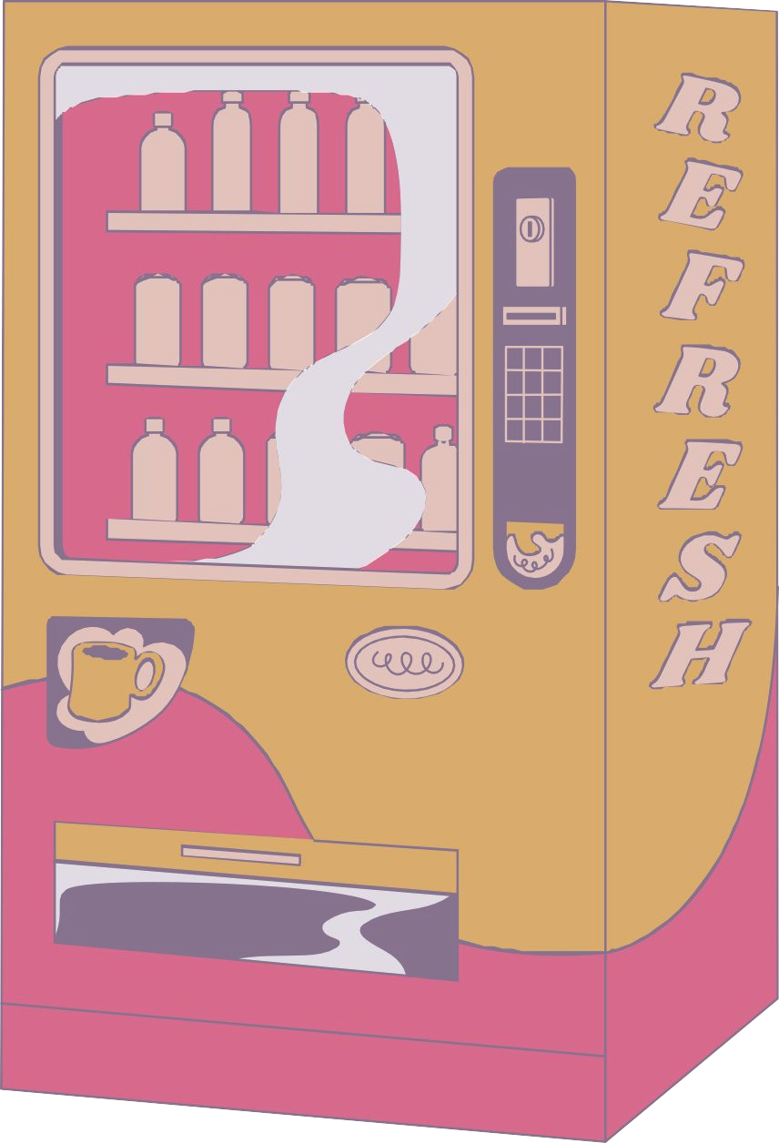
A B S T R A C
T
Developing a Java-based vending machine simulation system to replicate real-world vending scenarios.
This project focuses on creating a user-friendly interface that allows users to simulate product selection, payment processes, and inventory management. By providing an immersive experience, this system serves as an educational tool for understanding vending machine operations. Through the Java programming language, users can gain practical insights into the complexities of vending machine mechanics, which can be beneficial for both developers and individuals interested in the vending industry.

Slide 4

D I F F E R E N T
A P P L I C T I O N U S E D
Java Swing:
For creating the graphical user interface (GUI).
Data Structures:
To manage product inventory efficiently.
Payment Processing: Implementing payment algorithms.
Randomization
:Simulating product availability and
selection.
User Input Handling:
For user interaction and product selection.
File I/O:
Storing and retrieving vending machine data.
Object-Oriented Programming: To model vending machine components.
Error Handling:
Ensuring smooth operation and user feedback.

Slide 5
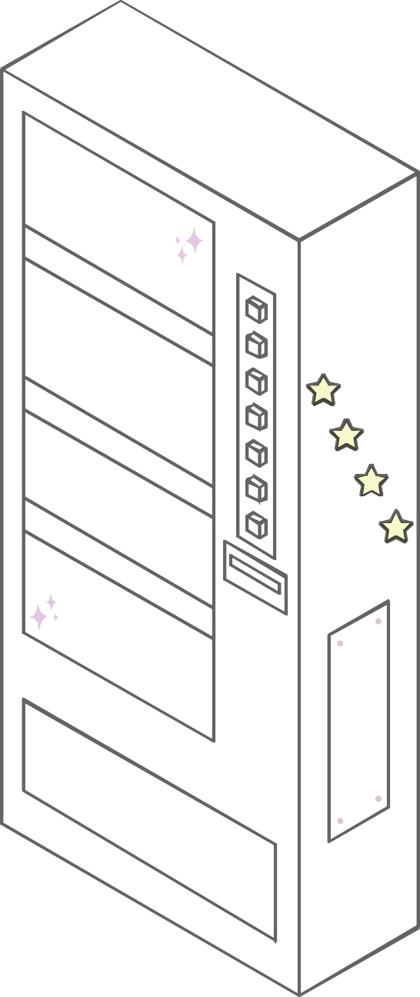








F U N C T I O N A L I T Y
Building a vending simulation machine in Java involves implementing key functionalities. Users can select products, triggering inventory deductions, and simulate coin/bill insertion for payment. It employs GUI elements for intuitive interaction. Error handling ensures smooth operation, providing user feedback for insufficient funds or sold-out items. Data structures manage inventory efficiently. Payment processing calculates change and updates balances. Object- oriented programming models vending components for modularity. File I/O stores and retrieves machine data, allowing users to track usage and inventory. Randomization simulates product availability and selection, enhancing the realism of the simulation

Slide 6
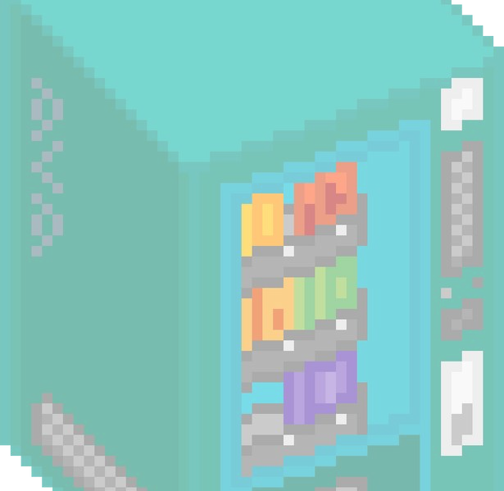
C H A L L E N E G E S
02
Another challenge lies in implementing a realistic payment system that calculates change accurately, handles various denominations, and manages different payment scenarios effectively. Simulating the unpredictability of real-world vending machines, including product availability and selection randomness, requires careful coding and balancing to provide an engaging and educational experience to users.
01
Building a vending simulation machine in Java involves tackling several significant challenges.
One challenge is creating a robust user interface that can handle user interactions, simulate coin and bill insertions, and provide a seamless experience. Managing inventory efficiently, considering factors like product restocking, tracking availability, and ensuring concurrent user access, is complex

Slide 7

I M P A C T S
Building a vending simulation machine in Java has significant impacts on education, skill development, and practical applications, benefiting developers, enthusiasts, and businesses.
Educational Value
Skill Enhancement
Building a vending simulation machine in Java improves programming and problem-solving skills, focusing on areas like error handling, data structures, and object-oriented programming, offering practical application and knowledge refinement.
Practical Application
The vending simulation machine in Java has practical applications for businesses and entrepreneurs, offering a safe, cost-effective platform for testing strategies, optimizing inventory, and exploring revenue opportunities.
Creating a Java-based vending simulation machine is a valuable educational tool for developers and enthusiasts, offering hands-on experience in understanding software systems like inventory management, user interfaces, and payment processing.

Slide 8
C O N C L U S I O N
Building a vending simulation machine using Java has several impactful outcomes. Firstly, it serves as a valuable educational tool, allowing developers and enthusiasts to understand and experiment with vending machine mechanics, enhancing their programming and problem-solving skills.
Secondly, it offers insights into inventory management, payment processing, and user interface design, which are applicable to broader software development contexts.
Furthermore, this simulation aids in refining error-handling and validation techniques, improving code quality and reliability. Additionally, it provides a platform for testing and refining business strategies related to vending machines, benefiting entrepreneurs and businesses interested in the vending industry. Overall, a vending simulation machine in Java has educational, developmental, and practical impacts, making it a valuable project with broad applications.

Slide 9
J A V A C O D E
import javax.swing.*;
import java.awt.*;
import java.awt.event.ActionEvent;
import java.awt.event.ActionListener;
import java.text.NumberFormat;
import java.util.HashMap;
import java.util.Locale;
import java.util.Map;
public class VendingMachineGUI {
private Map<String, Integer> inventory;
private Map<String, Integer> productQuantity;
private int balance;
private JFrame frame;
private JTextField balanceField;
private JTextArea productArea;
private JTextArea purchaseSummaryArea; // Added a new JTextArea for purchase summary
private JTextField coinField;
private JTextField purchaseField;
private JTextField quantityField;
private JButton purchaseButton;
public VendingMachineGUI() {
inventory = new HashMap<>();
productQuantity = new HashMap<>();
balance = 0;

Slide 10
frame = new JFrame("Vending Machine");
frame.setDefaultCloseOperation(JFrame.EXIT_ON_CLOSE);
frame.setSize(400, 400); // Increased frame height to accommodate new section
frame.getContentPane().setBackground(new Color(255, 255, 204)); // Light yellow background
frame.getContentPane().setForeground(Color.BLACK);
JPanel inputPanel = new JPanel();
balanceField = new JTextField("Balance: ₹0.00", 10);
coinField = new JTextField(5);
coinField.setBackground(Color.WHITE);
JButton insertCoinButton = new JButton("Insert Coin");
insertCoinButton.setBackground(Color.GREEN);
insertCoinButton.setForeground(Color.WHITE);
inputPanel.add(balanceField);
inputPanel.add(coinField);
inputPanel.add(insertCoinButton);
productArea = new JTextArea(10, 30);
productArea.setEditable(false);
productArea.setBackground(new Color(255, 255, 204)); // Light yellow background
productArea.setForeground(Color.BLUE);
purchaseSummaryArea = new JTextArea(5, 30);
purchaseSummaryArea.setEditable(false);
purchaseSummaryArea.setBackground(new Color(255, 255, 204)); // Light yellow background
purchaseSummaryArea.setForeground(Color.RED);

Slide 11
JPanel purchasePanel = new JPanel();
JLabel purchaseLabel = new JLabel("Enter Product Name:");
JLabel quantityLabel = new JLabel("Enter Quantity:");
purchaseField = new JTextField(10);
purchaseField.setBackground(Color.WHITE);
quantityField = new JTextField(5);
quantityField.setBackground(Color.WHITE);
purchaseButton = new JButton("Purchase");
purchaseButton.setBackground(Color.PINK);
purchaseButton.setForeground(Color.WHITE);
purchasePanel.add(purchaseLabel);
purchasePanel.add(purchaseField);
purchasePanel.add(quantityLabel);
purchasePanel.add(quantityField);
purchasePanel.add(purchaseButton);
frame.add(inputPanel, BorderLayout.NORTH);
frame.add(new JScrollPane(productArea), BorderLayout.CENTER);
frame.add(purchasePanel, BorderLayout.SOUTH);
frame.add(new JScrollPane(purchaseSummaryArea), BorderLayout.EAST); // Added a new JScrollPane for purchase summary
insertCoinButton.addActionListener(new ActionListener() {
@Override
public void actionPerformed(ActionEvent e) {
insertCoin(Integer.parseInt(coinField.getText()));
coinField.setText("");
}
});

Slide 12
purchaseButton.addActionListener(new ActionListener() {
@Override
public void actionPerformed(ActionEvent e) {
String product = purchaseField.getText();
int quantity = Integer.parseInt(quantityField.getText());
purchaseProduct(product, quantity);
purchaseField.setText("");
quantityField.setText("");
}
});
frame.setVisible(true);
}
public void addProduct(String product, int price, int quantity) {
inventory.put(product, price);
productQuantity.put(product, quantity);
}
public void insertCoin(int coin) {
balance += coin;
updateBalanceField();
}
public void displayProducts() {
productArea.setText("Available Products:\n");
for (String product : inventory.keySet()) {
int price = inventory.get(product);
int quantity = productQuantity.get(product);
productArea.append(product + " - ₹" + formatCurrency(price) + " (Quantity: " + quantity + ")\n");
}
}

Slide 13
public void purchaseProduct(String product, int quantity) {
if (inventory.containsKey(product)) {
int price = inventory.get(product);
int currentQuantity = productQuantity.get(product);
if (currentQuantity >= quantity) {
int totalPrice = price * quantity;
if (balance >= totalPrice) {
productArea.append("You purchased " + quantity + " " + product + " for ₹" + formatCurrency(totalPrice) + "\n");
// New section to show the name and quantity of the purchased product in the summary
purchaseSummaryArea.append("Purchase Summary:\n");
purchaseSummaryArea.append("Product: " + product + "\n");
purchaseSummaryArea.append("Quantity: " + quantity + "\n");
purchaseSummaryArea.append("Total Price: ₹" + formatCurrency(totalPrice) + "\n");
balance -= totalPrice;
currentQuantity -= quantity;
productQuantity.put(product, currentQuantity);
updateBalanceField();
} else {
productArea.append("Insufficient balance. Please insert more coins.\n");
}
} else {
productArea.append("Not enough " + product + " in stock.\n");
}
} else {
productArea.append("Product not found.\n");
}
}

Slide 14
private void updateBalanceField() {
balanceField.setText("Balance: ₹" + formatCurrency(balance));
}
private String formatCurrency(int amount) {
NumberFormat format = NumberFormat.getCurrencyInstance(new Locale("en", "IN"));
return format.format(amount);
}
public static void main(String[] args) {
SwingUtilities.invokeLater(() -> {
VendingMachineGUI vendingMachine = new VendingMachineGUI();
vendingMachine.addProduct("Soda", 20, 10);
vendingMachine.addProduct("Chips", 10, 15);
vendingMachine.addProduct("Candy", 10, 20);
vendingMachine.addProduct("Cookies", 10, 10);
vendingMachine.addProduct("Cake", 10, 10);
vendingMachine.addProduct("Juice", 20, 10);
vendingMachine.displayProducts();
});
}
}

Slide 15
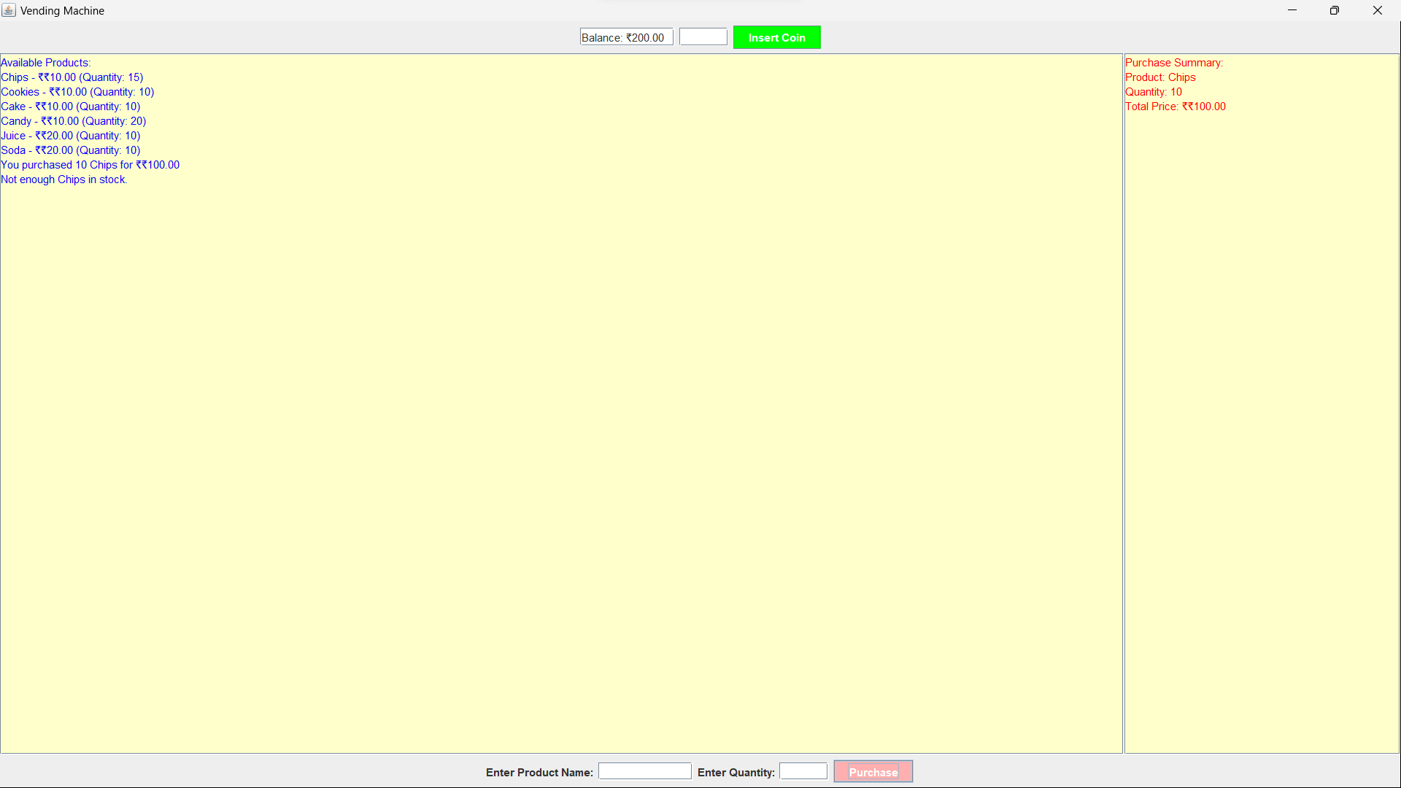
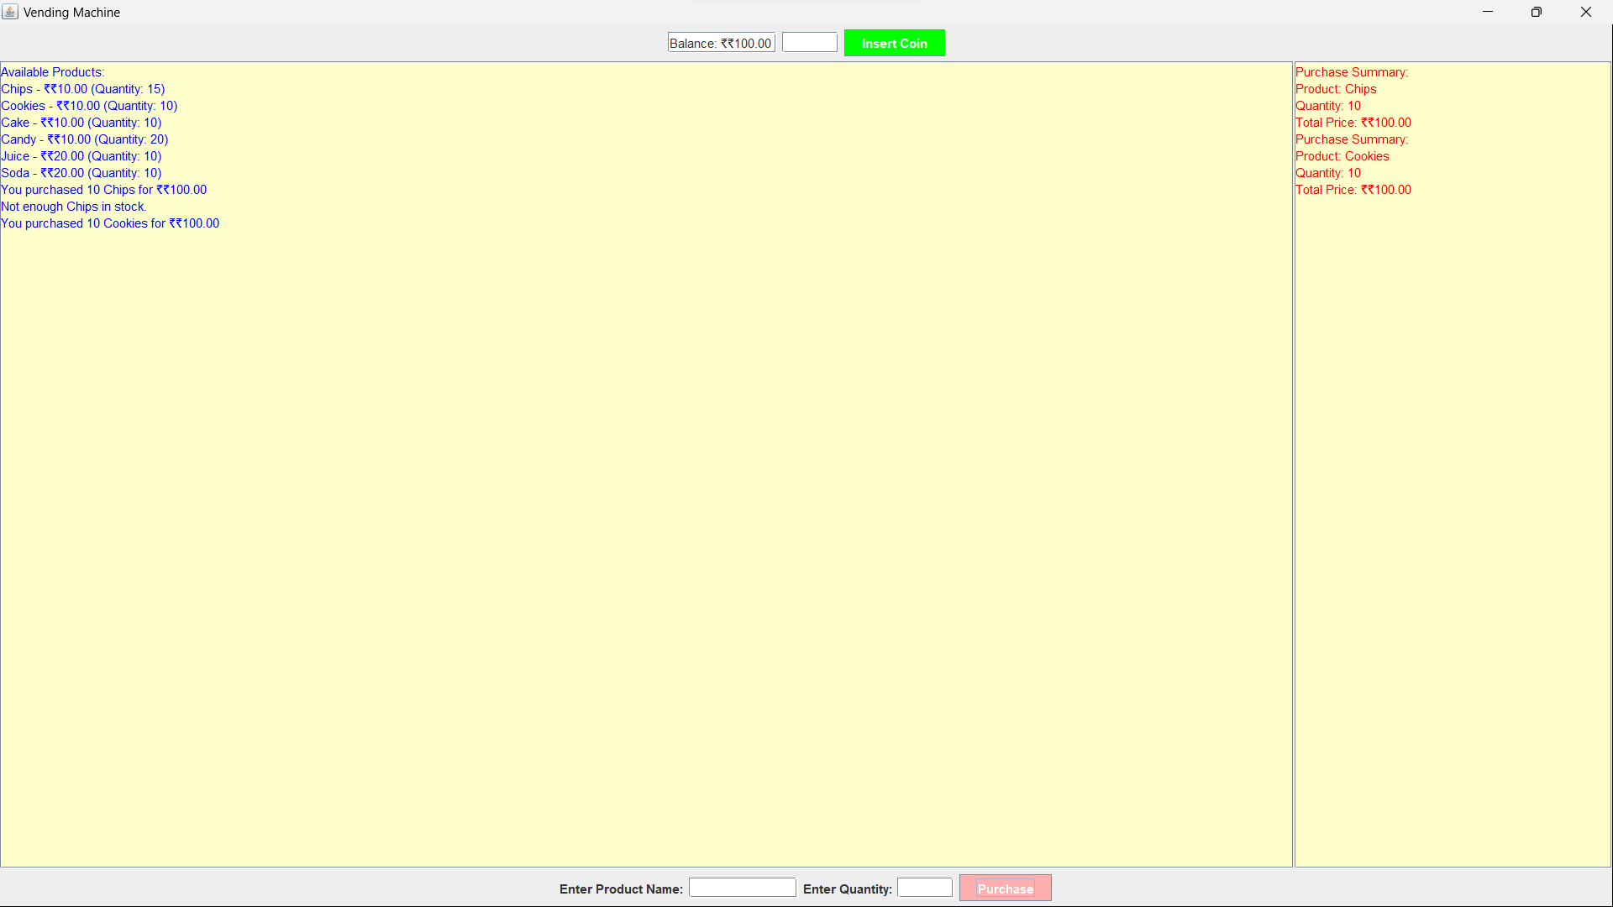
OUTPUT

